Slide 1
A Scalable Web Application Framework for Monitoring Energy Usage on Campus
Group 57: Daniel Schroeder, Aubrey Thenell, Parker Bruni

Slide 2
Introduction
Project Summary and Purpose
Oregon State University is revered for its energy efficiency and sustainability and is committed to reducing its carbon footprint through renovations and sustainable considerations with new projects. Our project aims to provide an web interface application to monitor the energy consumption data of Oregon State Campus buildings so organizations such as the OSU office of Sustainability may have better knowledge about infrastructure decisions regarding energy usage. This project will also replace the current implementation for monitoring energy usage on campus which has proven to be costly and inefficient.
Notes:
Oregon State University is revered for its energy efficiency and sustainability and is committed to reducing its carbon footprint through renovations and sustainable consideration with new projects. In this era of technology it is necessary to utilize the tools that are available to us when designing and implementing systems that will increase energy efficiency. Oregon State focuses on reducing its overall costs while supporting a more sustainable environment through less consumption and emissions. With this in mind, OSU has installed energy meters in campus buildings to monitor and record energy data so that it may be analysed by members of Oregon State University's Sustainability Office. The data that is gathered from these systems can be used to make educated decisions about the current energy usage systems in place, such as monitoring strange fluctuations or anomalies in energy usage in any given building. OSU can address and correct any potential waste from occurring as well as provide a foundation of knowledge to reference when planning future infrastructure projects by utilizing these systems.
The Sustainability Office has contracted the company “Lucid” to create a web application that displays all the data from these meters in an intuitive way. Lucid takes the raw data from the meters and provides an interface for the Sustainability Office to analyze. However, as Oregon State University Sustainability Office scales up its operations and automated reporting, the price of Lucid’s contract becomes exponentially expensive to maintain. In order for this data analysis to continue the Oregon State Sustainability office has recognized an opportunity for OSU engineering students to create and plan a project that can take the place of the current system which will also serve as our senior capstone project. By allowing the computer science department to take over this project, the Office of Sustainability will be able to have an internally sourced web application that can be modified to whatever specifications they desire. It will also allow the hundreds of thousands of dollars that was previously spent on Lucid’s services to be spent on more sustainable projects for the entire University and help Oregon State reach its carbon neutrality goal of 2025.

Slide 3
Introduction
Overview of Progress Report Topics
Proposed Solution
Goals and Stretch Goals
Research:
Structural and Server Side Frameworks
Web/Database Hosting and Database Framework
Visualization and Front-end Frameworks
Language and Authentication
Design of Interface Components
Current Progress
Issues Impeding Progress
Solutions to Problem of Progress Restrictions
Notes:
The topics that will be covered in detail within this progress report includes the following.
Our proposed solution to this issue
Our required goals and stretch goals for the project
Our research on technologies for the project, including
Structural and server side frameworks
Web hosting, database hosting, and database frameworks
Visualization and Front end frameworks
And Language and authentication
We will also discuss the design of interface components
Our current progress on the project
Issues that are impeding further progress
And solutions to those issues

Slide 4
Introduction
Overview of Application
Utilize the MEAN stack method of developing a web based application
Host the application and database on a web based platform (AWS EC2)
Read energy data from existing energy metering databases
Be accessible from a web browser with internet access
Have intuitive navigation tools such as navigation bars
Has various levels of privileges and control for user accounts (General, Authorized, Administrative)
Display energy usage data in an intuitive and presentable fashion
Notes:
In order for the application to be more easily understood, a description of the applications general overview is a good idea.
The application will utilize the MEAN stack method of developing a web based application.
The application and database will be hosted on a web based platform, specifically the Amazon Web Services platform EC2.
It will read energy data from existing energy metering databases as well as populate with new data as it arrives.
It will be accessible from any web browser with internet access.
It will have intuitive navigation tools such as navigation bars and an organized UI structure.
It will have various levels of privileges and control for user accounts specifically, General Users, Authorized Users, and Administrative Users
And it will display energy usage data in an intuitive and presentable fashion so that the data can be appropriately analyzed

Slide 5
Introduction
Overview of Project Goals and Stretch Goals
Required Goals
Allow administrative accounts to control various parts of the website without coding knowledge
Display “Blocks” of data, including graphs and charts of energy data
Display arrangements of Blocks known as “Dashboards”
Allow for groupings of Dashboards known as “Stories”
Create pages with a default Dashboard associated with each building
Stretch Goals
Create cost tables and invoices for energy billing
View billing trends and information
Allow for mobile data entry to the database
Notes:
The application will not be officially complete until our required goals are met.
If we happen to complete our required goals before our deadline, we will focus on set of stretch goals
The required goals include:
Allow for administrative accounts to control various parts of the website without coding knowledge
Display “Blocks” of energy data, including graphs and charts
Display arrangements of Blocks known as “Dashboards”
Allow for groupings of Dashboards known as “Stories”
And Creat building pages with a default Dashboard associated with the building
Our stretch goals include:
Creating cost tables and invoices for energy billing
Producing billing trends and billing information
And allowing for data to be entered mobily to the database

Slide 6
Introduction
Documentation of Project
Problem Statement
Requirements Document
Technology Review
Design Document
Progress Report
Documents found at: https://github.com/DSchroederOSU/SeniorCapstone
Notes:
For those who may be interested in more details about our project, the following documents have been created and are located at the github provided
Our problem statement discusses the definition and description of the problem we are solving
The requirements document goes into detail about the goals and requirements of the project.
The technology review discusses the technologies we used, potential technologies that may have been used, and why we chose the technologies that we did.
The design document covers the overall design we aim to follow for this project
And the progress report is the written version of this presentation.

Slide 7
Notes:
We will now begin to discuss the project in more detail, starting with the research of our technologies used for this project.

Slide 8
Research and Design Decisions
Frameworks and utilities used
Components used
UI design of components
Aubrey

Slide 9
Transition Slide

Slide 10
Research and Design Decisions
Frameworks and utilities used
Components used
UI design of components
Aubrey

Slide 11


Research: Structural and Server Side Frameworks
AngularJS
ExpressJS
Image Sources:
https://www.w3schools.com/angular/pic_angular.jpg
https://camo.githubusercontent.com/fc61dcbdb7a6e49d3adecc12194b24ab20dfa25b/68747470733a2f2f692e636c6f756475702e636f6d2f7a6659366c4c376546612d3330303078333030302e706e67
Aubrey

Slide 12


Research: Web/Database Hosting and Database Framework
Amazon Web Services
MongoDB
Image Sources:
https://a0.awsstatic.com/main/images/logos/aws_logo_smile_1200x630.png
https://cms-assets.tutsplus.com/uploads/users/1116/posts/24835/preview_image/mongodb-logo.png
Aubrey

Slide 13


Research: Visualization and Front-end Frameworks
D3.js
Bootstrap
Image Sources:
https://raw.githubusercontent.com/d3/d3-logo/master/d3.png
https://camo.githubusercontent.com/5d417873a11d7175ec40fc3af3c6cb024a531dd7/68747470733a2f2f676574626f6f7473747261702e636f6d2f6173736574732f6272616e642f626f6f7473747261702d736f6c69642e737667
Aubrey

Slide 14


Research: Language and Authentication
node.js
Google oAuth2.0
Image Sources:
https://nodejs.org/static/images/logos/nodejs-new-pantone-black.png
https://cdn.tutsplus.com/net/uploads/2013/07/oauth-retina-preview.jpg
Aubrey

Slide 15
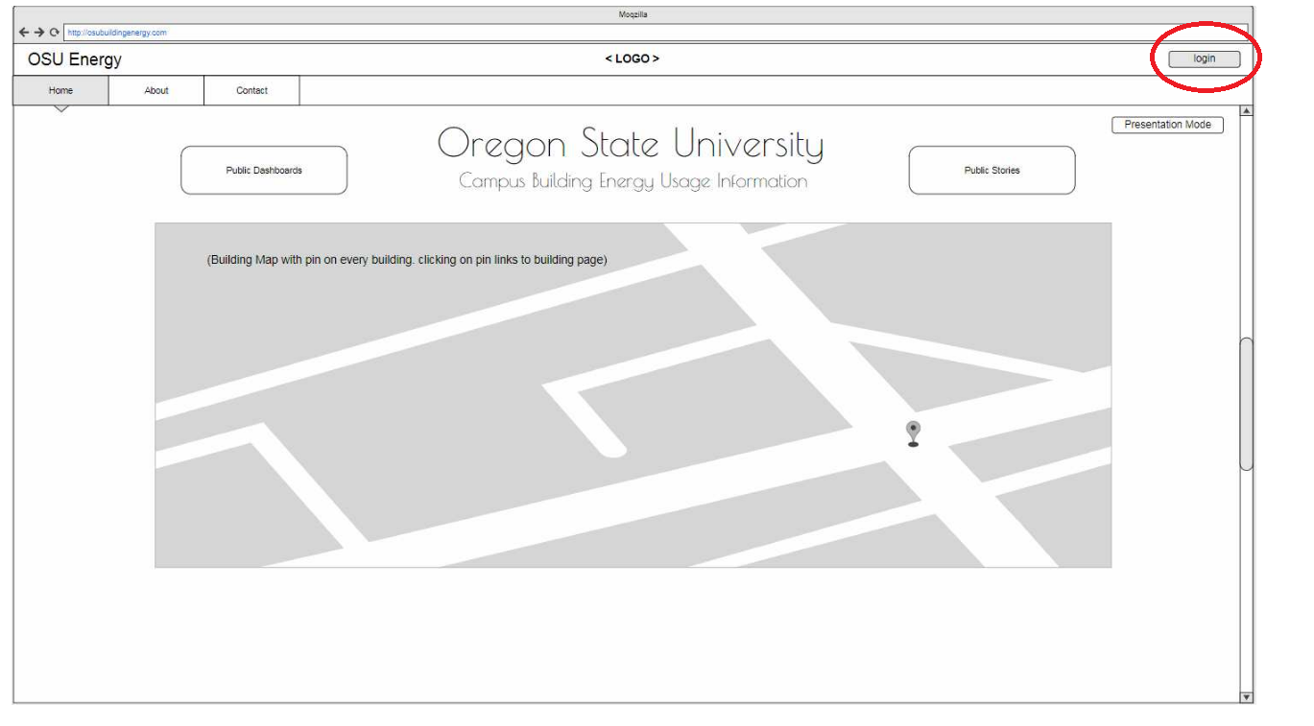
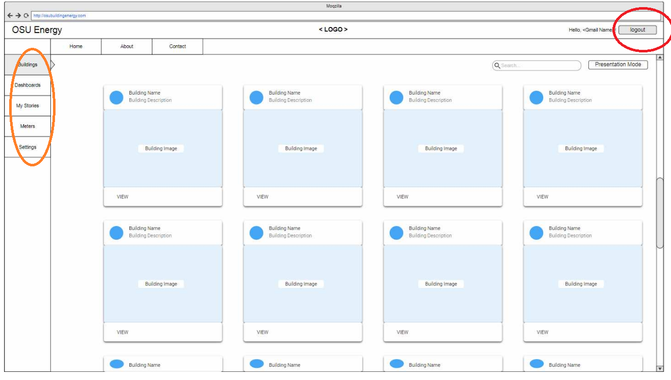
Design: Components
Login
Logged in
Aubrey

Slide 16
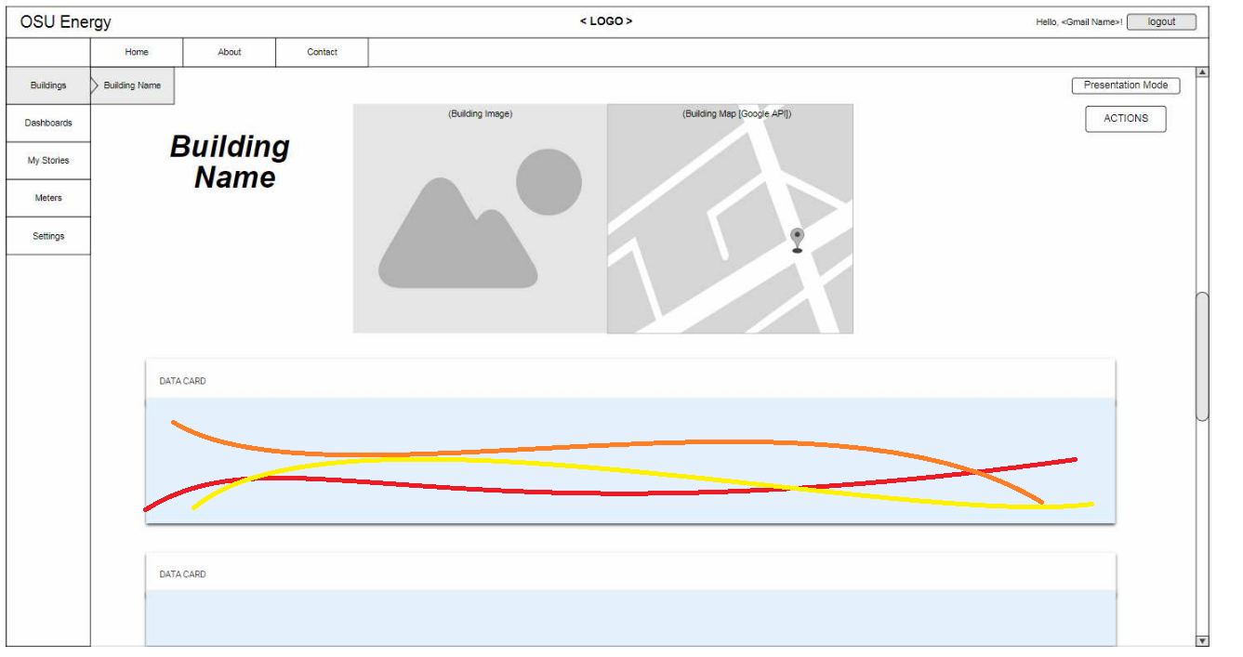
Design: Components
Block/Graph
Aubrey

Slide 17
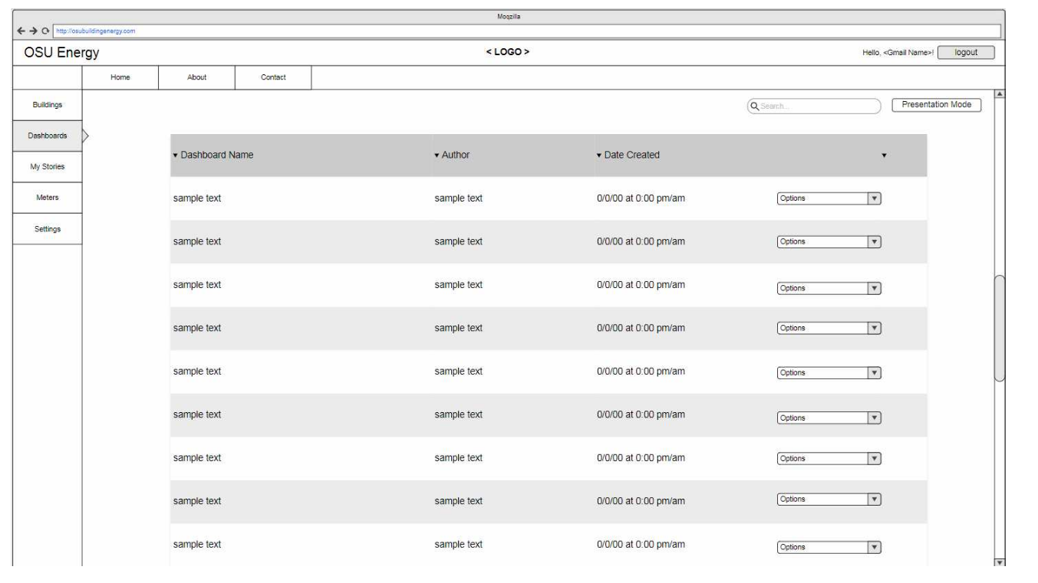
Design: Components
Dashboard
Aubrey

Slide 18
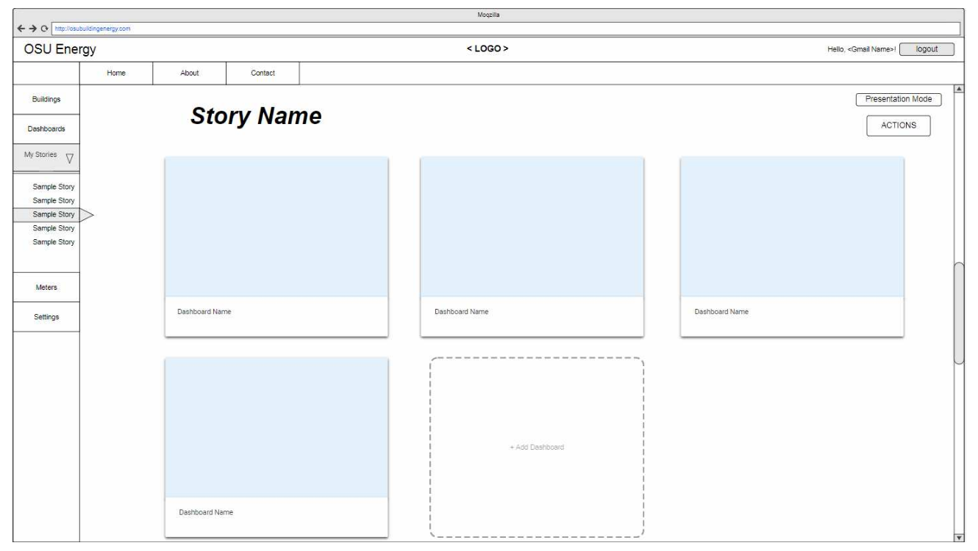
Design: Components
Stories
Aubrey

Slide 20
Current Status
Usable product: None.
Smaller-scaled solutions: Multiple.
Research: Average.
Plans for execution: Bountiful.
Notes:
The current status of our project is as modular as the component designs themselves. We have a lot of bits and pieces completed and abstract ideas for implementations, but no sourced product to show for it. This has been mainly due to time constraints and logistical issues with our client and hosting environment.

Slide 21

Issues Impeding Progress
Biggest source of pain: AWS.
Source: https://sdtimes.com/amazon-aws-s3-outage-causing-widespread-issues-businesses/
Notes:
In order to host the application so that it is accessible outside of our local development scope, we need a hosting solution for both the application server and the database. Our team and clients have chosen to host the application on AWS, potentially making use of the Bitnami MEAN stack development environment. The issue currently is that our client has taken control of setting up this account, which has not yet been completed; meaning we have no place to push source code and launch an application other than locally.

Slide 22
Issues Impeding Progress: AWS
Solutions:
Local development of small scaled solutions.
Notes:
In response to our lack of host solution, we have begun implementing some of the designs, frameworks, and systems that have presented themselves over the course of the term. Through completing the assignments and undergoing research, we have began designing data models, components, and system architectures that outline a possible solution for our application.
Among these small scale solutions,
a successful web socket application to dynamically render content to the screen as requests are sent from the application server. This will hopefully provide a starting point for retrieving data from our acquiSuite data acquisition servers and rendering the new data to the page as it is received.
An application that utilizes Google’s oAuth 2.0 authentication API to authenticate users by their google token, mongodb, dynamically serving new content to the page with nav item and ANgular injections.

Slide 23
Local Solution: WebSocket
Key resources: npm “ws” package as WebSocket client and server
Create a WebSocket server with a specific port.
Serve the WebSocket server when serving the application server.
Send incremental data from the WebSocket server.
Receive data in the page of the application.

Slide 24
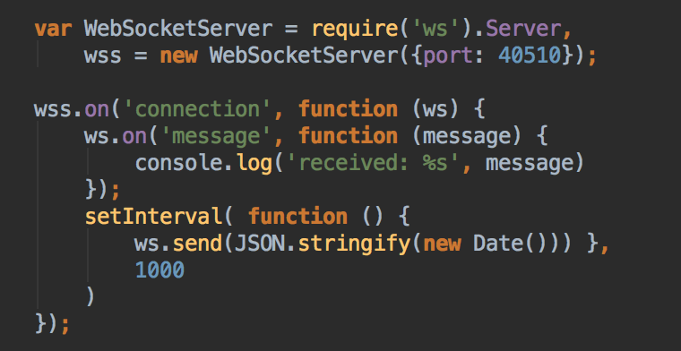
Local Solution: WebSocket
The websocket server is extremely simple to set up.

Slide 25
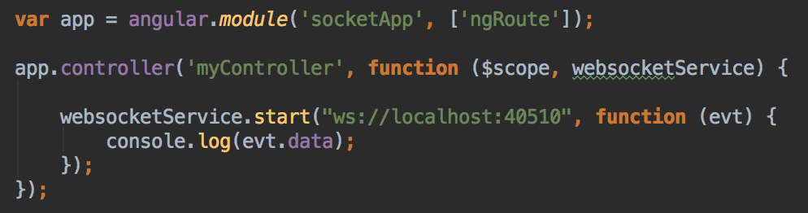
Local Solution: WebSocket
Within the AngularJS controller, the application starts a connection with the WebSocket server and receives data sent.
Our application formats the Date( ) object sent from the WebSocket server and passes it to a scope variable to simulate a real-time clock that updates every second.

Slide 26
Local Solution: WebSocket
Outcomes:
Higher understanding of Angular frameworks and injecting page data.
Working implementation of a WebSocket server with real-time data updates.

Slide 27
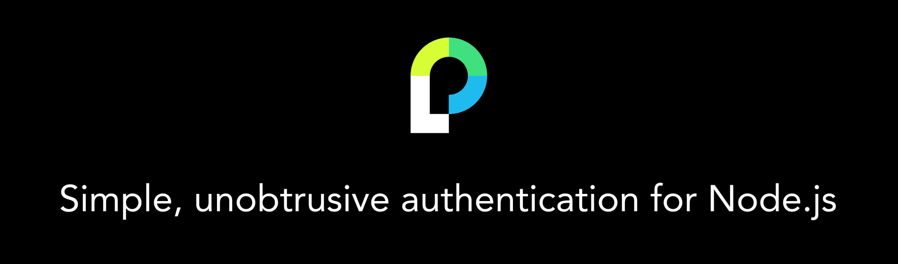
Local Solution: Authentication
Key resources: passport.js
Require passport.js authentication middleware
Redirect user to Google oAuth 2.0 API
Store Google token in user object
Authenticate user through sessions
Photo Source: https://github.com/jaredhanson/passport

Slide 28
Local Solution: Authentication
Passport.js
“Authenticating requests is as simple as calling passport.authenticate() and specifying which strategy to employ.” - passport.js documentation
Import Google strategy
var GoogleStrategy = require('passport-google-oauth').OAuth2Strategy;
Use Google strategy in route
app.get('/auth/google',
passport.authenticate('google', { scope : ['profile', 'email'] }));
Notes:
Passport.js is a very robust authentication middleware that simplifies authentication into simple function calls and strategies.
Passport has a built in Google strategy that handles google authentication.
And our route simply uses this strategy when called:

Slide 29
Local Solution: Authentication
Passport documentation to setup Google strategy.
Route middleware.
app.get('/route, isLoggedIn, function(req, res) {}
// route middleware to make sure a user is logged in
function isLoggedIn(req, res, next) {
// if user is authenticated in the session, carry on
if (req.isAuthenticated())
return next();
// if they aren't redirect them to the home page
res.redirect('/');
}
Notes:
Creating the Google Strategy is a little more complicated, but is fully document in the passport.js documentation.
There is route middleware to authenticate users every time a new route is called through the isLoggedIn function. This will make allow us to only serve content to appropriate users.

Slide 30
Local Solution: Authentication
Outcomes:
Simple Node.js authentication strategies
Using Google for authentication
Remove the need for passwords in the database
Keep track of users throughout session
Authenticate content being served with middleware
Notes:
Creating the Google Strategy is a little more complicated, but is fully document in the passport.js documentation.
There is route middleware to authenticate users every time a new route is called through the isLoggedIn function. This will make allow us to only serve content to appropriate users.

Slide 31
Local Solution: MongoDB
Key resources: MongoDB
Storing data and rendering dynamic content.
User submits form
AngularJS service posts to a route
Route handles data creation and database insertion
AngularJS injects new data to the page
Notes:
We have also began to explore the power of mongoDB and the capabilities of accessing data through AngularJS services.
A small scale application uses forms insert objects in an array in the user model and dynamically updates content on the page as new data is acquired.

Slide 32
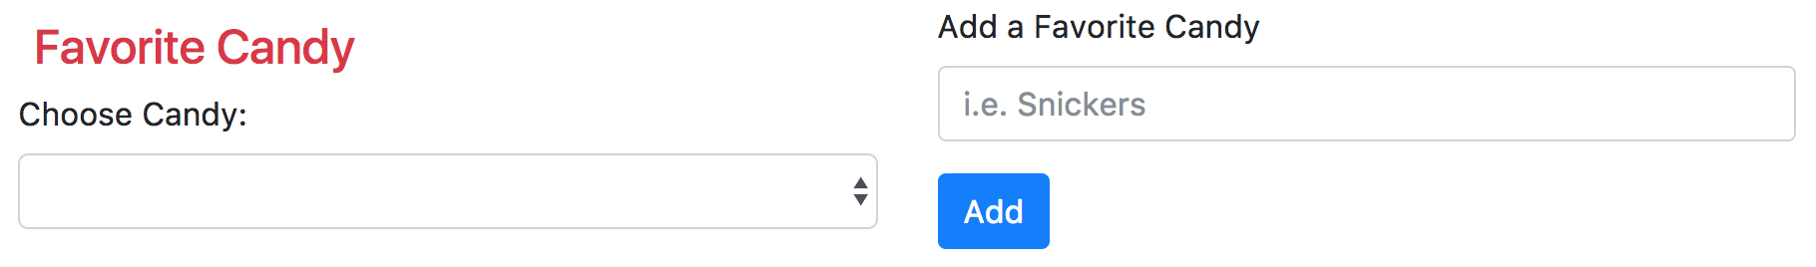
Local Solution: MongoDB
Add favorite candy
Notes:
A simple form that asks for a candy name to add to a collection of favorite candies.
The form submit button has an Angular attribute for ng-click which calls a function AddCandy specified in the controller which gets called on submission

Slide 33
Local Solution: MongoDB
In the Angular service:
.factory('AddCandy', function($http) {
return {
create : function(candyData) {
return $http.post('/api/candy', candyData);
},
}
});
In routes.js
app.post('/api/candy', function(req, res) {
var new_candy = {name: req.body.text};
req.user.candy.push(new_candy);
user.save(function(err) {
if (err)
throw err;
res.json(req.user.candy); // return all candy in JSON format
});
});
Notes:
The controller calls a service factory function which posts a request to a route
The route inserts the text from the form into the user’s candy array and then send a response of all the users candy if it was a success.

Slide 34
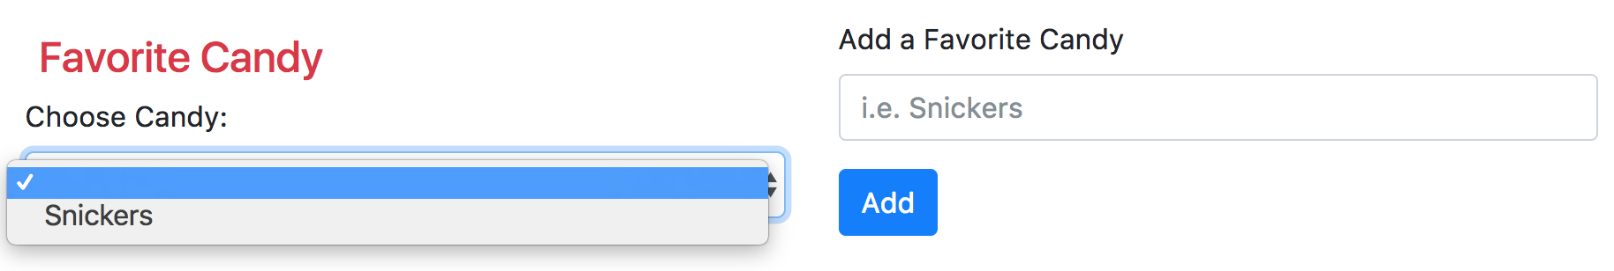
Local Solution: MongoDB
AngularJS loads the data from the route response into the drop down menu.
Notes:
Upon response from the route, the drop down menu’s ng-options receives the new candy array from the response from the route and adds the new data to the list of options dynamically. All of this happens without a page reload.

Slide 35
Local Solution: MongoDB
Outcomes:
Storing objects to a MongoDB database
Pulling data from a MongoDB database
Dynamically updating data on the page based on changes to the database
Using AngularJS factory functions as services
AngularJS attributes like ng-options, ng-click, and ng-include
Notes:
This is a small scale example of how we will allow users to add new objects in our application and update page content dynamically. Users will be able to fill our forms to create new buildings and add meters to the database which should be done in a similar fashion. This application also allowed us to configure MongoDB locally for use in a node application, which will differ slightly when hosting on AWS, but similar.

Slide 36
Local Solution: Dynamic Page Content
Serving new html to the content container from navigation bar
User chooses a navigation item
Navigation item posts route to parent scope variable
AngularJS attribute ng-include calls the selected route
New HTML is sent from the route to the page
Notes:
Our navigation bar will change the content of the view container without redirecting the user to a new url and causing a page reload. Being able to use AngularJS framework to inject static content to the page and dynamically render new material will allow us to create modular components and services to handle simple tasks and update page content when specifically needed.

Slide 37
Local Solution: Dynamic Page Content
//navigation.html
<li class="nav-item">
<a class="nav-link" href="" ng-click="$parent.viewPath='/profile'">
Home</a>
</li>
<li class="nav-item">
<a class="nav-link" href="" ng-click="$parent.viewPath='/story'">
Stories</a>
</li>
//index.html
<div class="container-fluid mt-1">
<div class="row" >
<nav id="navigation" class="">
<div ng-include="'/navigation"></div>
</nav>
<main role="main" class="col-sm-9 ml-sm-auto col-md-10 pt-3">
<div ng-controller="profileController" ng-include="viewPath"></div>
</main>
</div>
</div>
//routes.js
app.get('/route', isLoggedIn, function(req, res) {
res.render('route.html', {
user : req.user // get the user out of session and pass to template
});
});
Pass route as variable
Call Route
Send html
Notes:
Each nav item in our navigation has a route associate with it’s ng-click attribute
When an item is clicked, this route gets passed to the $parent.viewPath variable
When the page receives this new route, it calls the get function for that route which calls res.render on a particular static html file.
The ng-include AngularJS attribute in the index.html page then injects that html into the page and renders new content to the screen.

Slide 38
Local Solution: Dynamic Page Content
Outcomes:
Learn about AngularJS scopes and nested scopes
Inject static html to the content container
Create a practical navigation component
Notes:
This small scale implementation allowed us to research and learn different ways to serve static content and serve different views to the web page.
We were also able to learn more about AngularJS scopes and how to pass information in and out of nested scopes.
This will prove very helpful when we start developing our final application by allowing us to create modular views that can be templated and filled with dynamic data as the user navigates throughout the application.

Slide 39
Conclusion
Plans moving forward:
Begin heavy development over winter break in preparation for winter term
If AWS issue does not resolve, take matters into our own hands
Begin pushing code to a collective source repository
Convert applications to complement our project’s specific needs
Notes:
Over winter break, we plan to all be present for the majority of the break and able to work on developing the application code. We would like to get a nice working product by the start of winter term so that we can begin fine tuning and usability testing. Over winter break we would also like to convert all the strategies we learned in our small scale applications to satisfy our projects direct needs. For example, creating a dynamic form submission for adding a building with all its necessary data attributes.
In all, I think our team benefited a lot from the research and assignments this term and we were able to focus the scope of a huge web application into smaller modular components and subsystems that will provide all the necessary functionality laid out by the clients requirements.

